Slide 1

SEO REPORT
7 March 2026 – 7 April 2026
https://bestpsychicsadashiva.com/

Slide 2
SUMMARY
Google Search Console
● Over view of preformance
● GSC Queries
● Page index
● Links

Slide 3
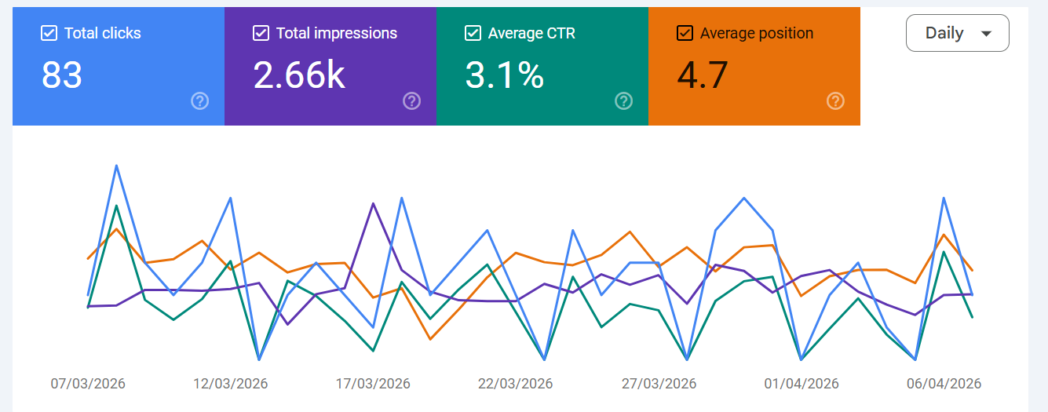
Over view of preformance

Slide 4
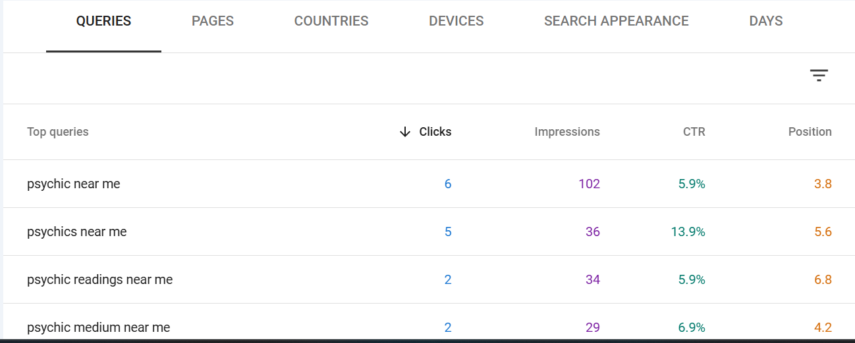
GSC Queries

Slide 5
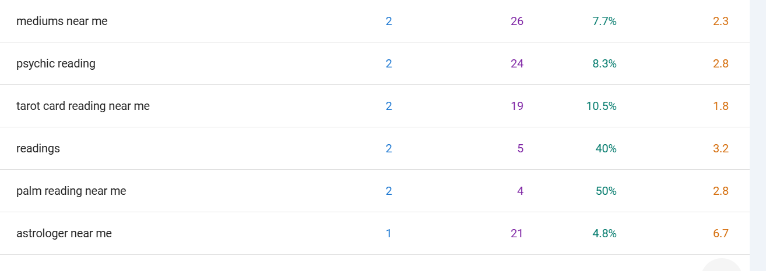

Slide 6
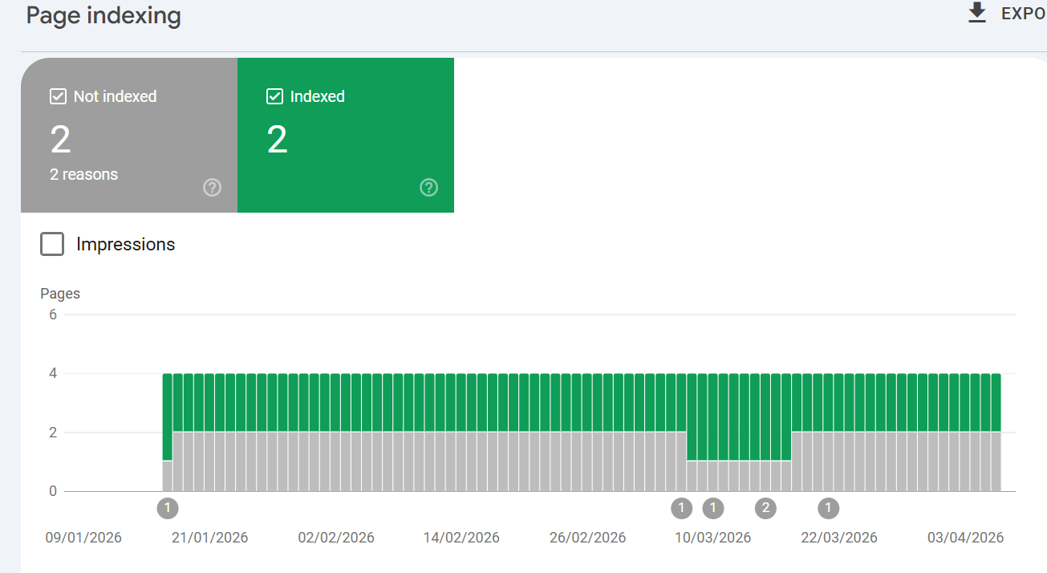
Page Indexing

Slide 7
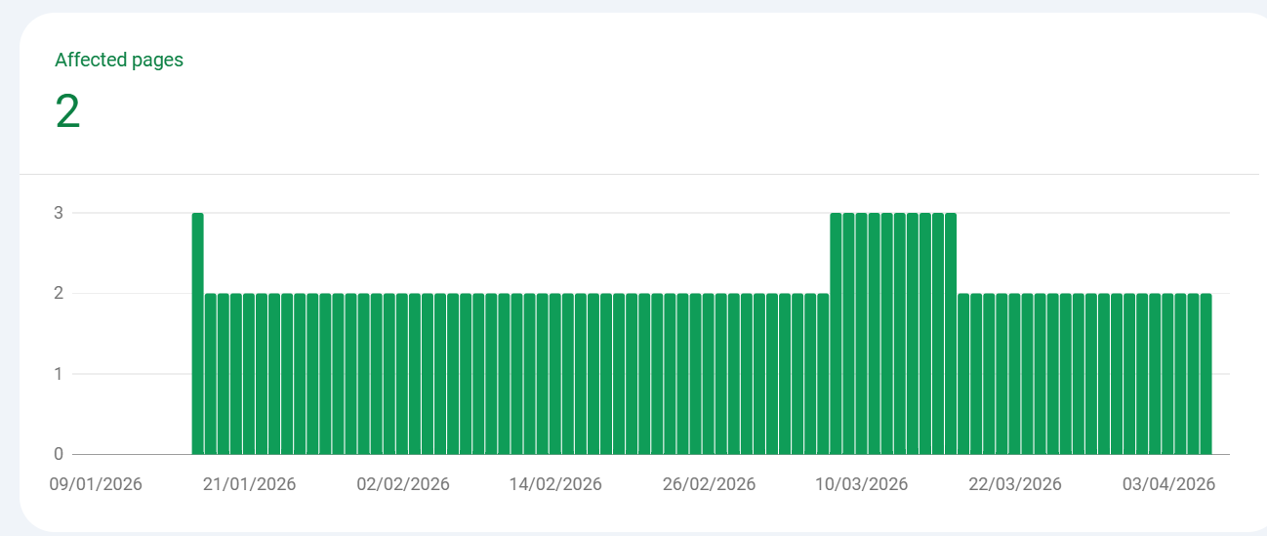
Index page

Slide 8
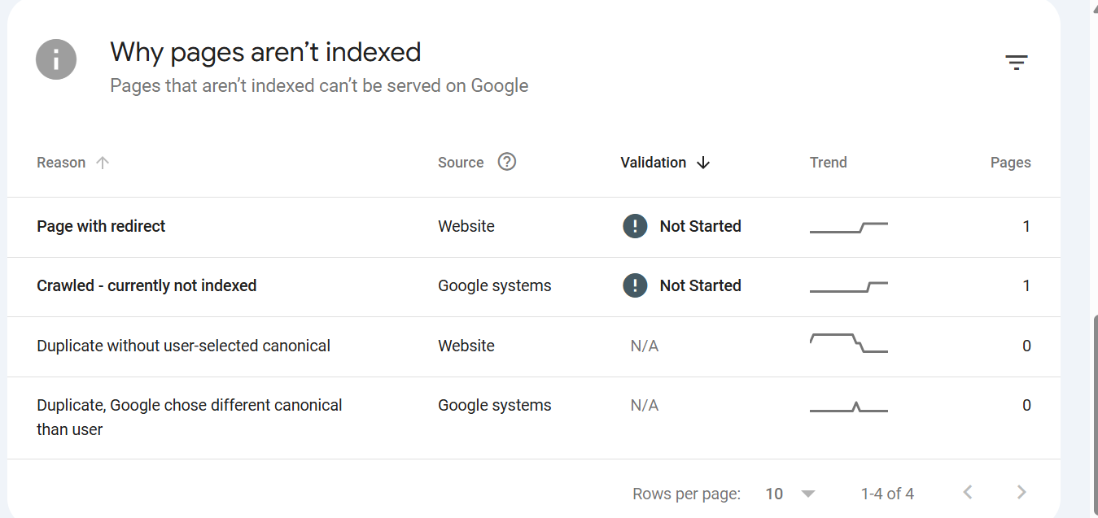
Not Index pages Reason

Slide 9
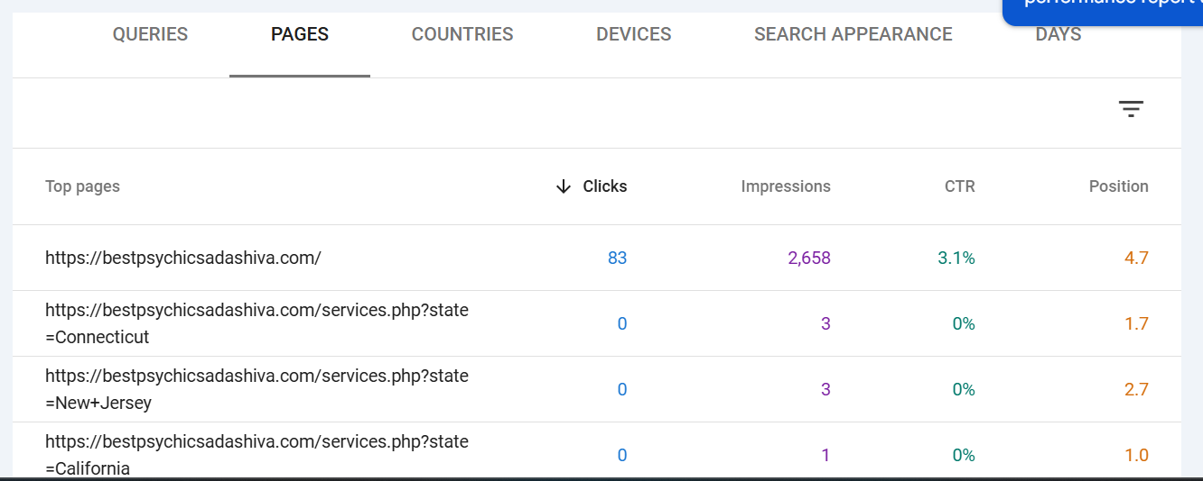
Google Search Console Connects the Top Pages

Slide 10
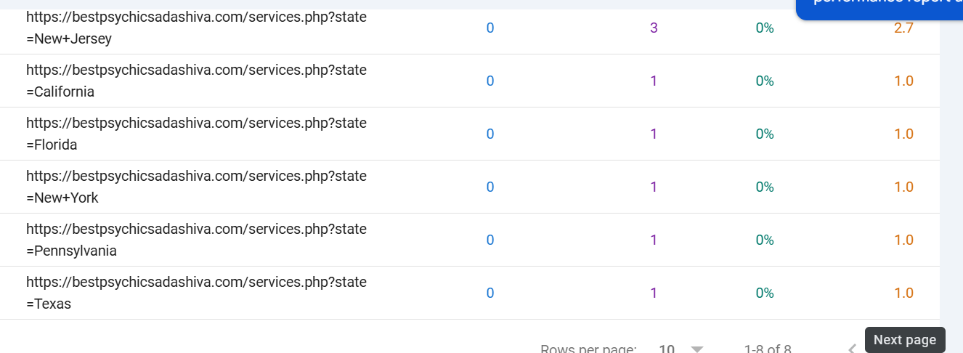

Slide 11
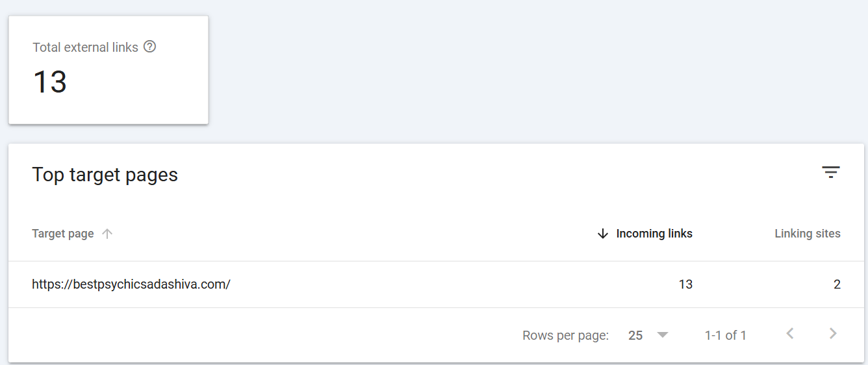
External links

Slide 12
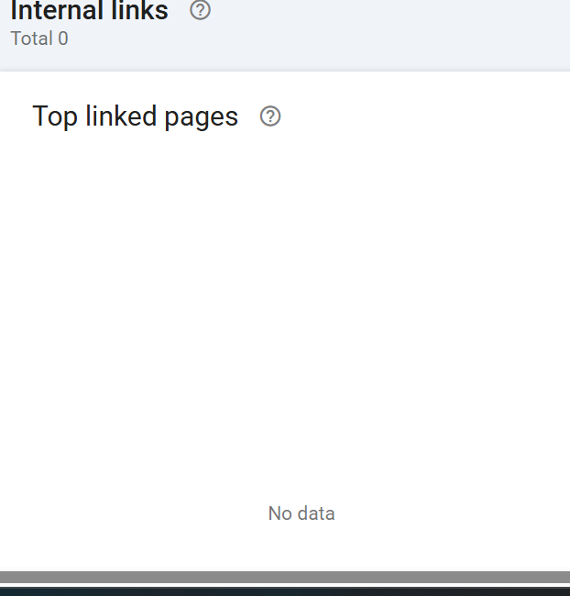
Internal links

